Slide 1
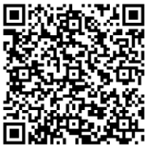
LYNDEN HIGH SCHOOL
SENIOR NIGHT
PLEASE SIGN IN
Notes:
Erin

Slide 3
Topics for Today
LYNDEN HIGH SCHOOL
SENIOR NIGHT
Important Dates
Graduation Requirements
High School and Beyond Plan
Applying to College
FAFSA/WASFA process
Josten’s: Cap & Gowns
Yearbook
Notes:
Erin

Slide 4
Upcoming Dates
October 21-25 – Cap & Gown Order Week
October 21- WAVE Tour @Skagit Valley College- students interested in apprenticeship and workforce (construction, Maritime, Mechanics, & more).
October 24- BP Field Trip- Those interested in working at the Refinery.
December 13 – Senior pictures/quotes due for yearbook
January 22 – Financial Aid Night
January 23 High School and Beyond Plan Due
June 6 - GRADUATION
Notes:
Erin

Slide 5
Lynden High School Graduation Requirements
Earn 25 credits (CLASS OF 2025)
High School And Beyond Plan
Complete a State Pathway
Postsecondary Education
State Test, AP, Transition Course, Dual Credit or Combination
CTE Course Pathway
2.0 Credits in a CTE course sequence
Military Career Interest
ASVAB
Notes:
Els

Slide 6
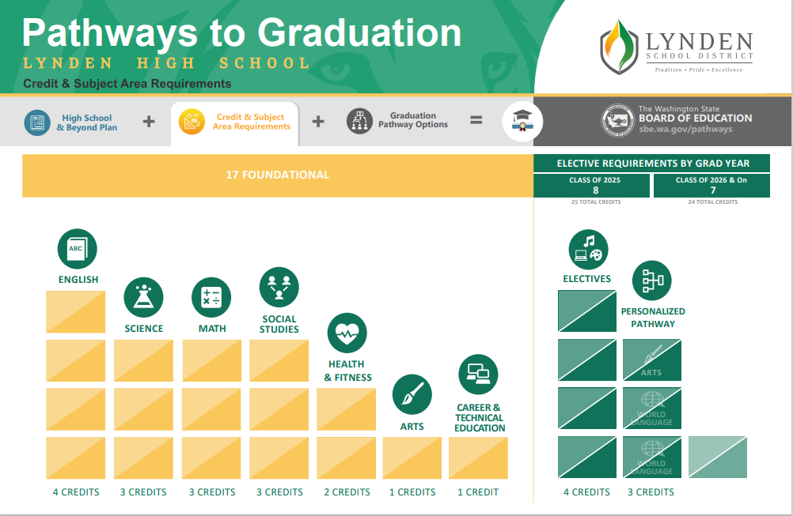
Notes:
Els

Slide 7
High School and Beyond Plan
Create a “4-Year Plan” that charts out your courses in HS
Engage in Interest and Aptitude surveys
Develop a resume
Learn about post-secondary and financial aid options
Reflect on and communicate about your Pathway and Post-HS goals
When is it due? January 23
COMPLETE TONIGHT!!!!
Notes:
Lois

Slide 8
Post Graduation Options
University
Community College
Technical College
Military
Apprenticeships
Work Force
Explore, Travel, Mission
Notes:
Heids

Slide 9
Applying to 4-Year Colleges/University
Applications & Deadlines
SAT/ACT
Transcripts
Letters of Recommendations
Essays
Notes:
Heids

Slide 10
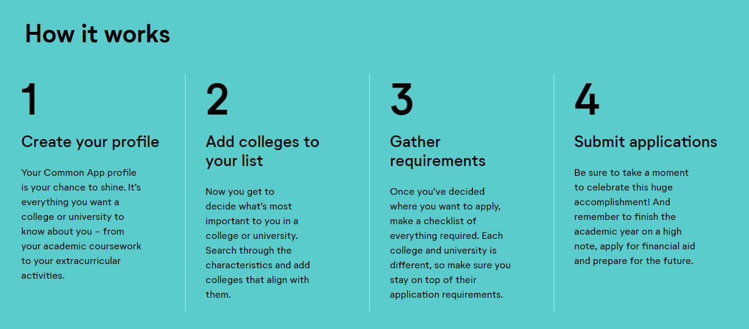
Common Application – CommonApp.org
(Online platform where students can apply to multiple schools with one application)
Transcripts
Essay
1-2 Teacher Letters of Recommendation
Counselor Recommendation
Notes:
Heids

Slide 11
Washington Guaranteed Admissions Program
How do I access this?
Apply!
Notes:
Ian

Slide 12
Community and Technical Colleges
Free to apply
Easy to enroll
Graduate high school or be 18 years old
Still send FAFSA/WASFA to schools
Transfer degrees or AA/certificate options
Common Options for Our Students:
Whatcom Community College
Bellingham Technical College
Skagit Valley College
Everett Community College
Notes:
Heids

Slide 13
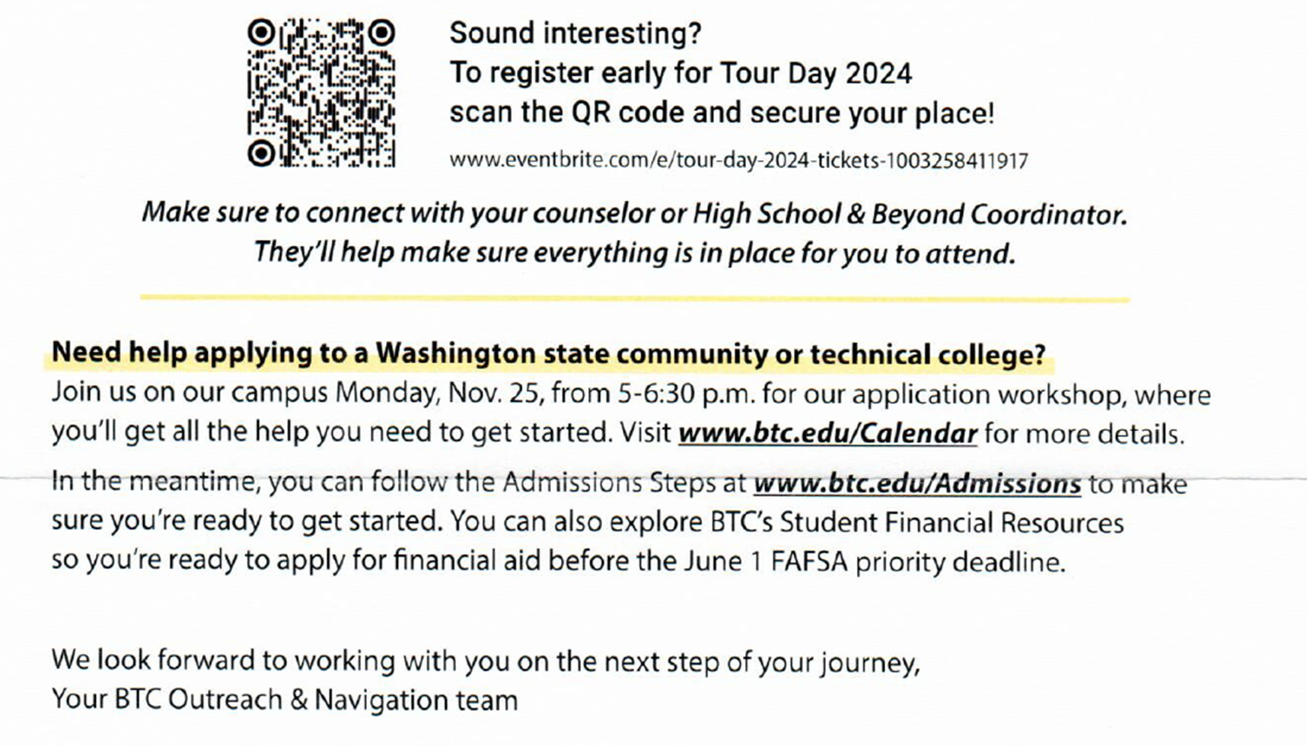
Bellingham Technical College Direct Admission
Notes:
Lois

Slide 14
Learn the Trades w/Ms. Mehlhoff
BTC Tour Day
WAVE Tours
BP Refinery
Learning with Leaders-Skagit Valley College
Notes:
Lois

Slide 15
College Vocabulary
Regular Decision | Submit application by institution's specified date and receive a decision within a stated period
Rolling Admission | Institution reviews applications as they are submitted and renders admissions decisions to students throughout the admissions cycle
Early Action | Students apply early to an institution and receive a decision in advance of the regular response date. Students admitted under Early Action are not obligated to accept the offer of admission. Early Action is non-binding.
Early Decision | Students make a commitment to a first-choice institution, where, if admitted, they will definitely enroll. Early Decision is binding, meaning students may not withdraw their acceptance.
Notes:
Els

Slide 16
SAT/ACT Updates
Check SAT/ACT website for future dates
Most universities are test optional
Do NOT require SAT/ACT scores for admission
Placement in English/Math courses
Reasons to consider taking the SAT:
Grades/transcript do not accurately reflect your ability to be successful in college
Scholarships
SAT - CollegeBoard.org
Confirm with your university
ACT – ACT.org
List of Colleges dropping & reinstating ACT/SAT
Notes:
Els

Slide 17
Guide to Paying for College
FAFSA/WASFA
Grants- Needs based
Work Study
Loans- Subsidized and unsubsidized
Financial Awards from Schools
Merit Based Scholarships
Athletics, Arts, Music, Leadership
Endowments- $ from the school
Needs Based Scholarships- College Bound
Scholarships from outside organizations
CSS Profile
Notes:
Erin

Slide 18
FAFSA/WASFA:
It’s a Process, Not an Event
Financial Aid Night @ LHS- January 22nd
CREATE YOUR PIN 3 weeks before starting the application
Send it to schools you are applying to
March - Award Letters sent out
Select School
Decide on financial aid package
Notes:
Erin

Slide 19
Scholarships
Local
State
LHS Scholarship WebPage
WashBoard.org
National
FastWeb
CollegeBoard
Rolling Timeline
Most January-April
Rolling Timeline
College Bound Scholarship
Notes:
Lois

Slide 20
Cap & Gown Orders
Order week: 10/21-10/23
Jostens.com
Required:
Cap, Gown, Stole, Tassel
All orders go through Jostens
Jostens was here last week during Activity Period. Pick up a packet in the office if you missed it.
Notes:
ian

Slide 21
Notes:
Mason

Slide 22
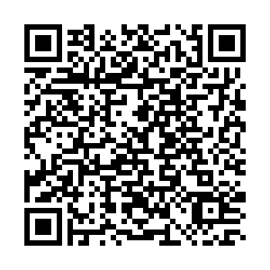
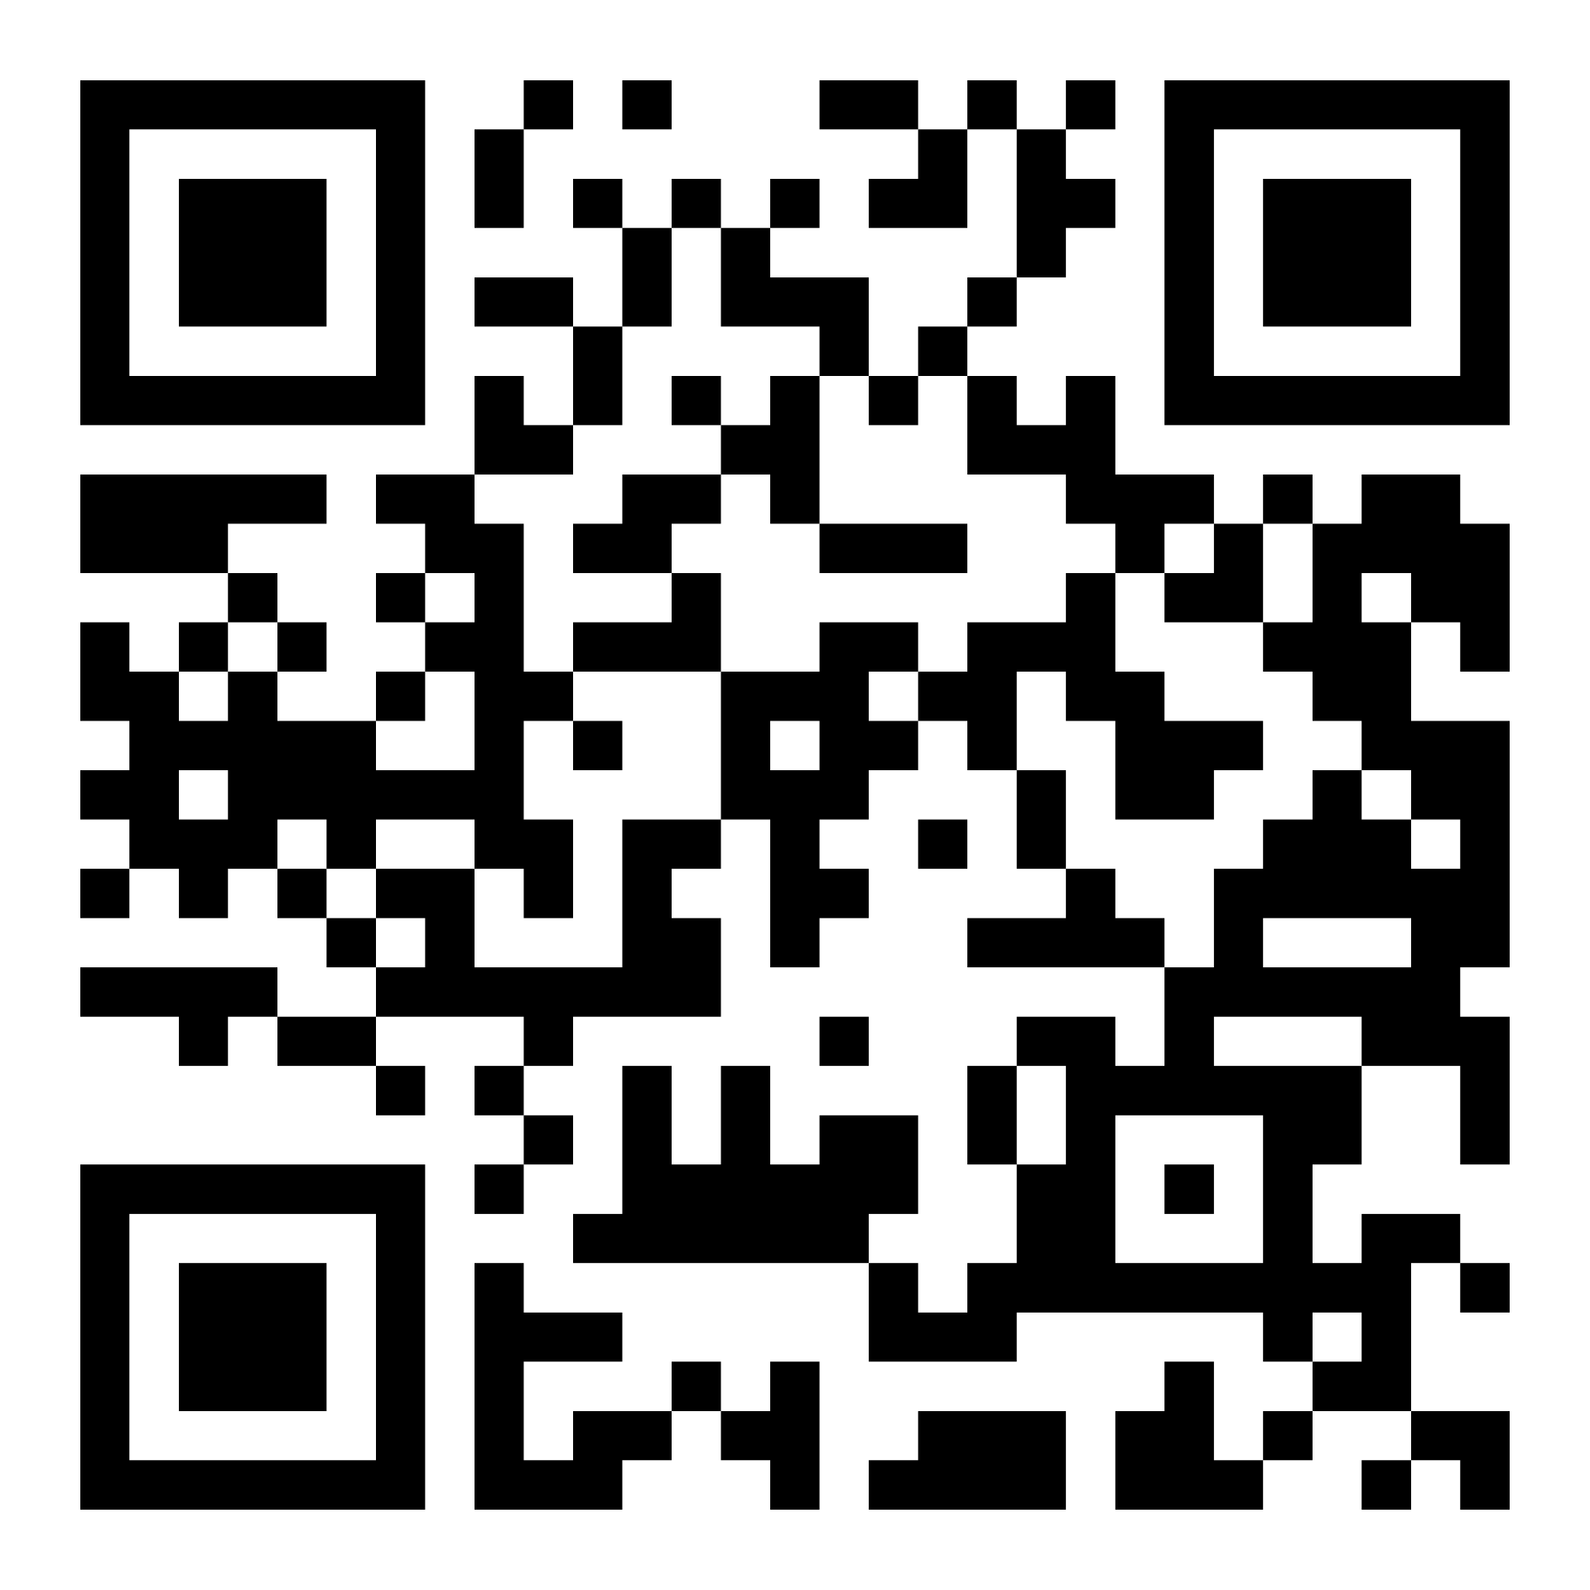
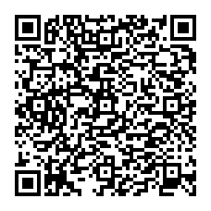
To schedule an appointment
Scan the QR code that aligns
with your student's LAST NAME
Mrs. Elsner
Last Names A - G
Mrs. Shaffer
Last Names H - O
Mrs. Lynch
Last Names P - Z
Notes:
Lois

